Slide 1
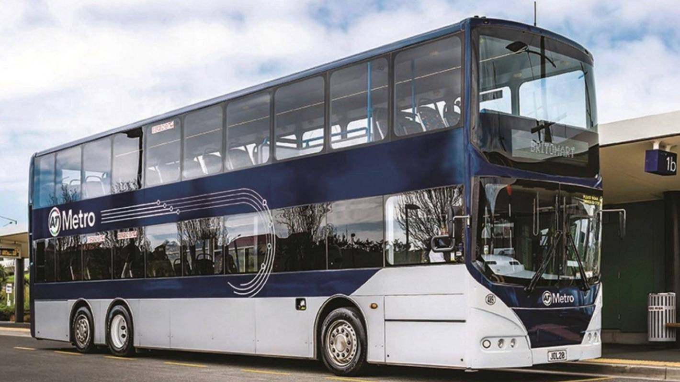
Real Time Bus Headway Estimation
Colby Roy Carrillo
Supervisor: Professor Thomas Lumley
Masters of Professional Studies - Data Science

Slide 2
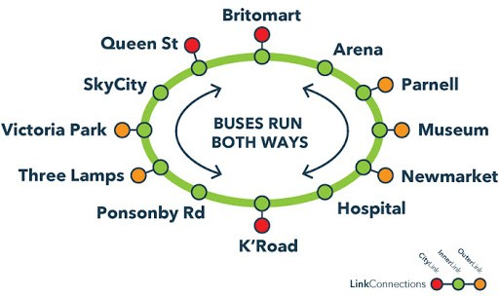
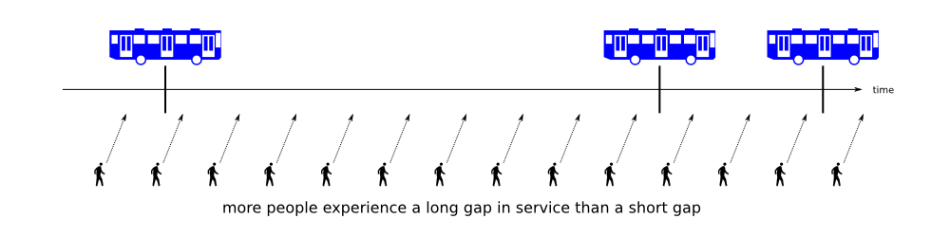
What is Headway?
Headway - “the time interval between two vehicles traveling in the same direction on the same route”
[1]
[1] Danish, P. byM. (2015, November 8). MBTA Bus Performance Data. Retrieved from https://willbrownsberger.com/mbta-bus-performance-data/.

Slide 3
Research Question
The twitter bot @tuureiti keeps track of how close Auckland's buses are to their timetabled schedules. For frequent services (such as the Inner Link, the Northern Express, the 70 along Gt South Rd, or the 27 along Mt Eden Rd) it's more important to keep track of the time between buses. That is, if there's a bus every 15 minutes, people will typically just go to the bus stop when they are ready, and they just care how long they have to wait. Having every bus 10 minutes late is better than having alternate buses on time and 10 minutes late. Transport nerds call this problem "maintenance of headway". The goal of the project is to work out a way to summarise headway from Auckland Transport's real-time data and to write software that computes and displays these summaries. Would require good R programming skills.
On-time vs Headway
Estimate next headway with only previous
Notes:
For buses that come frequently, in our study focusing under approximately 16 minutes on average, users normally do not check when the next bus is scheduled.
With this being the case the users are more concerned with how long they will have to wait for the next bus is to arrive.
I set out with the goal to create an application to pull, store, and analyze the data during busy hours, approximately 7 AM to 10 PM.

Slide 4
Three Estimators of Headway
Observed Headway (Actual)
Mixed Headway (Part Observed / Part Estimated)
Current Headway (Completely Estimated)

Slide 5
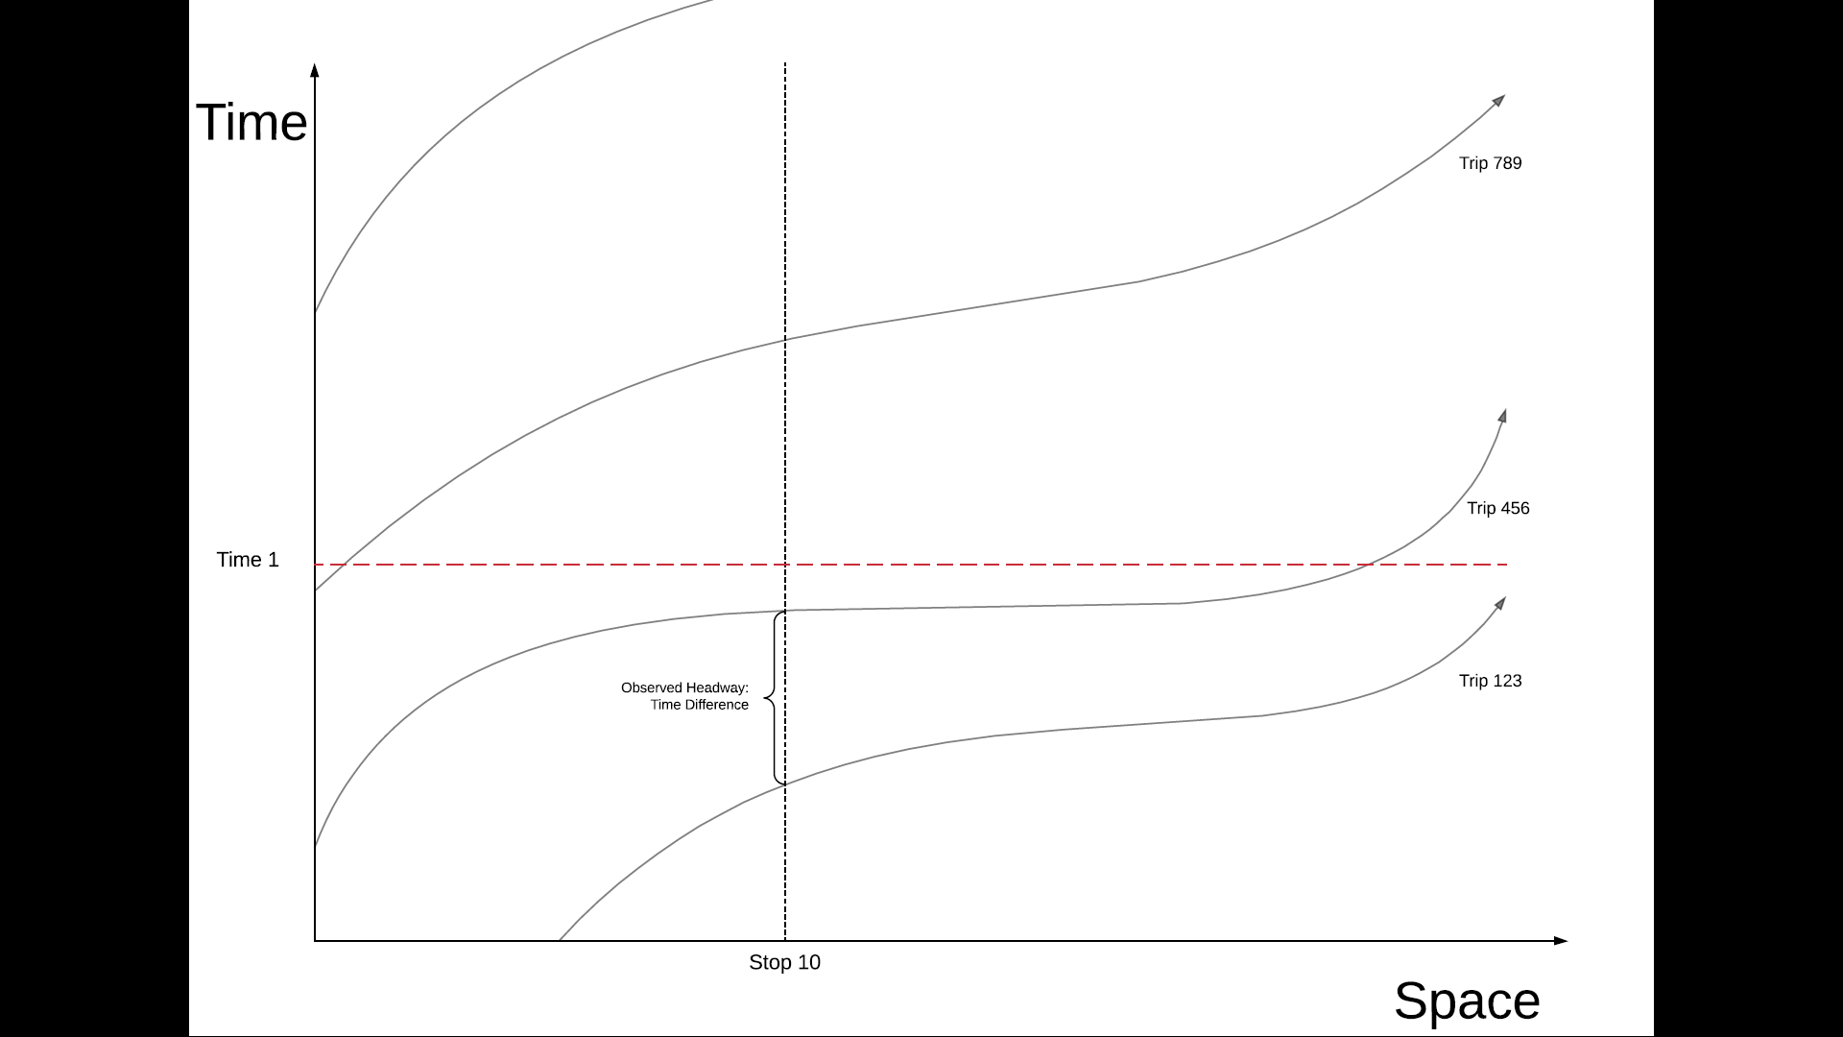
Observed Headway

Slide 6
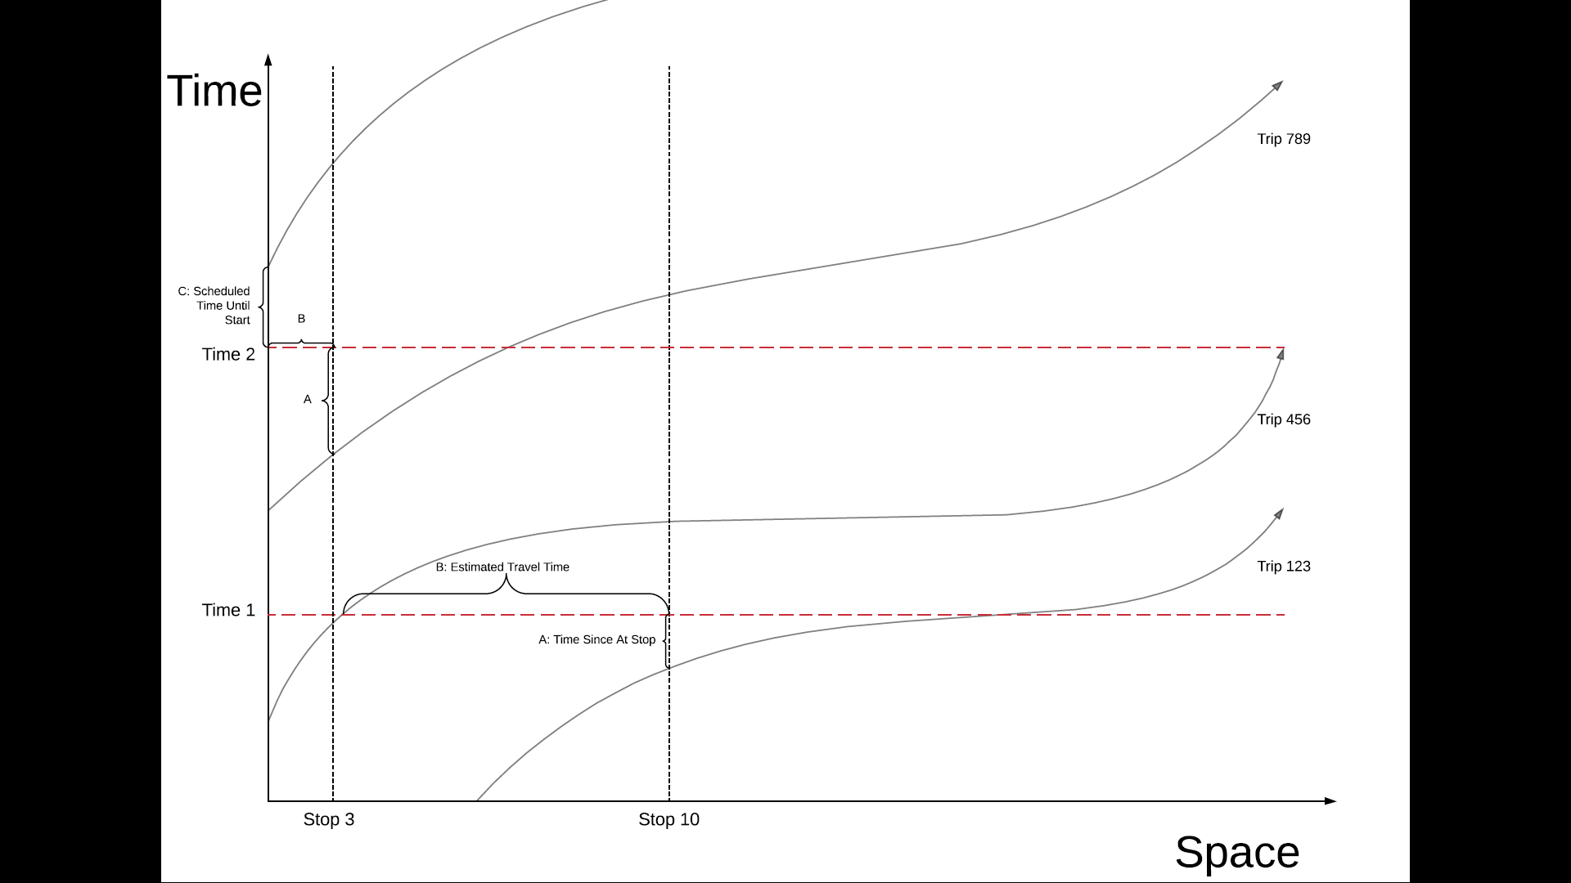
Mixed Headway

Slide 7
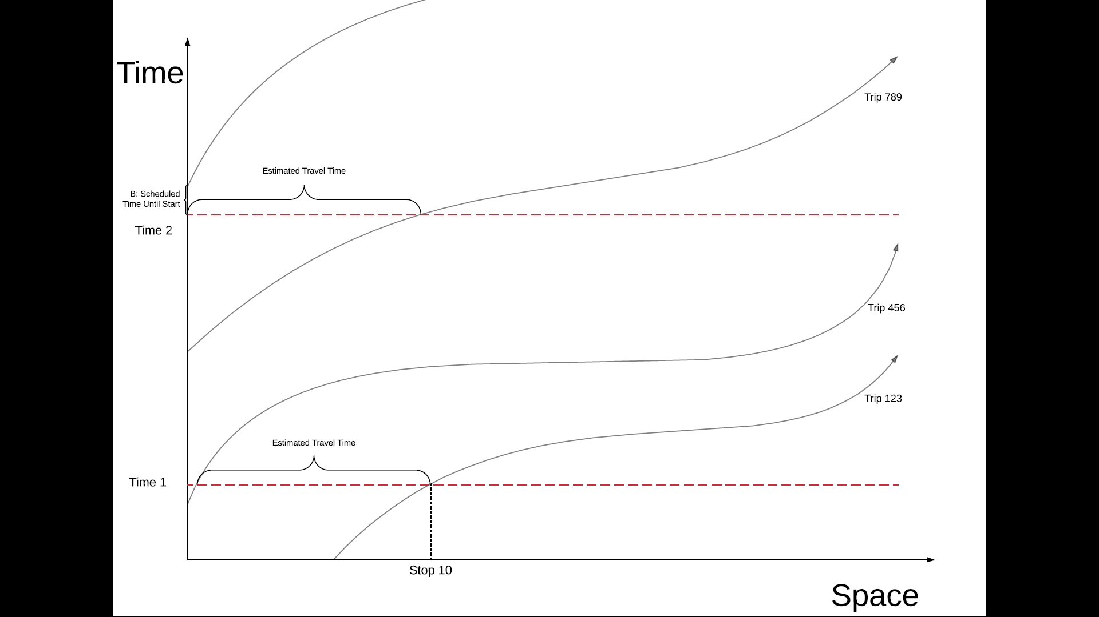
Current Headway

Slide 8
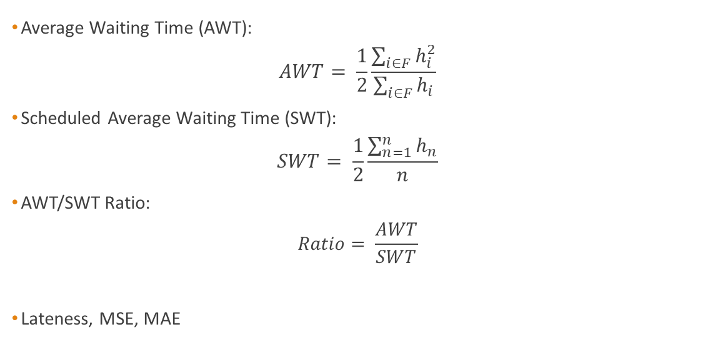
Important Calculations
Average Waiting Time (AWT): $AWT= \frac{1}{2}\frac{\sum_{i∈F}{h_{i}^{2}}}{\sum_{i∈F}{h_{i}}}$
Scheduled Average Waiting Time (SWT): $SWT= \frac{1}{2}\frac{\sum_{n=1}^{n}{h_{n}}}{n}$
AWT/SWT Ratio: $Ratio= \frac{AWT}{SWT}$
Lateness, MSE, MAE
Poisson Process – Independent Arrivals
[1]

Slide 9
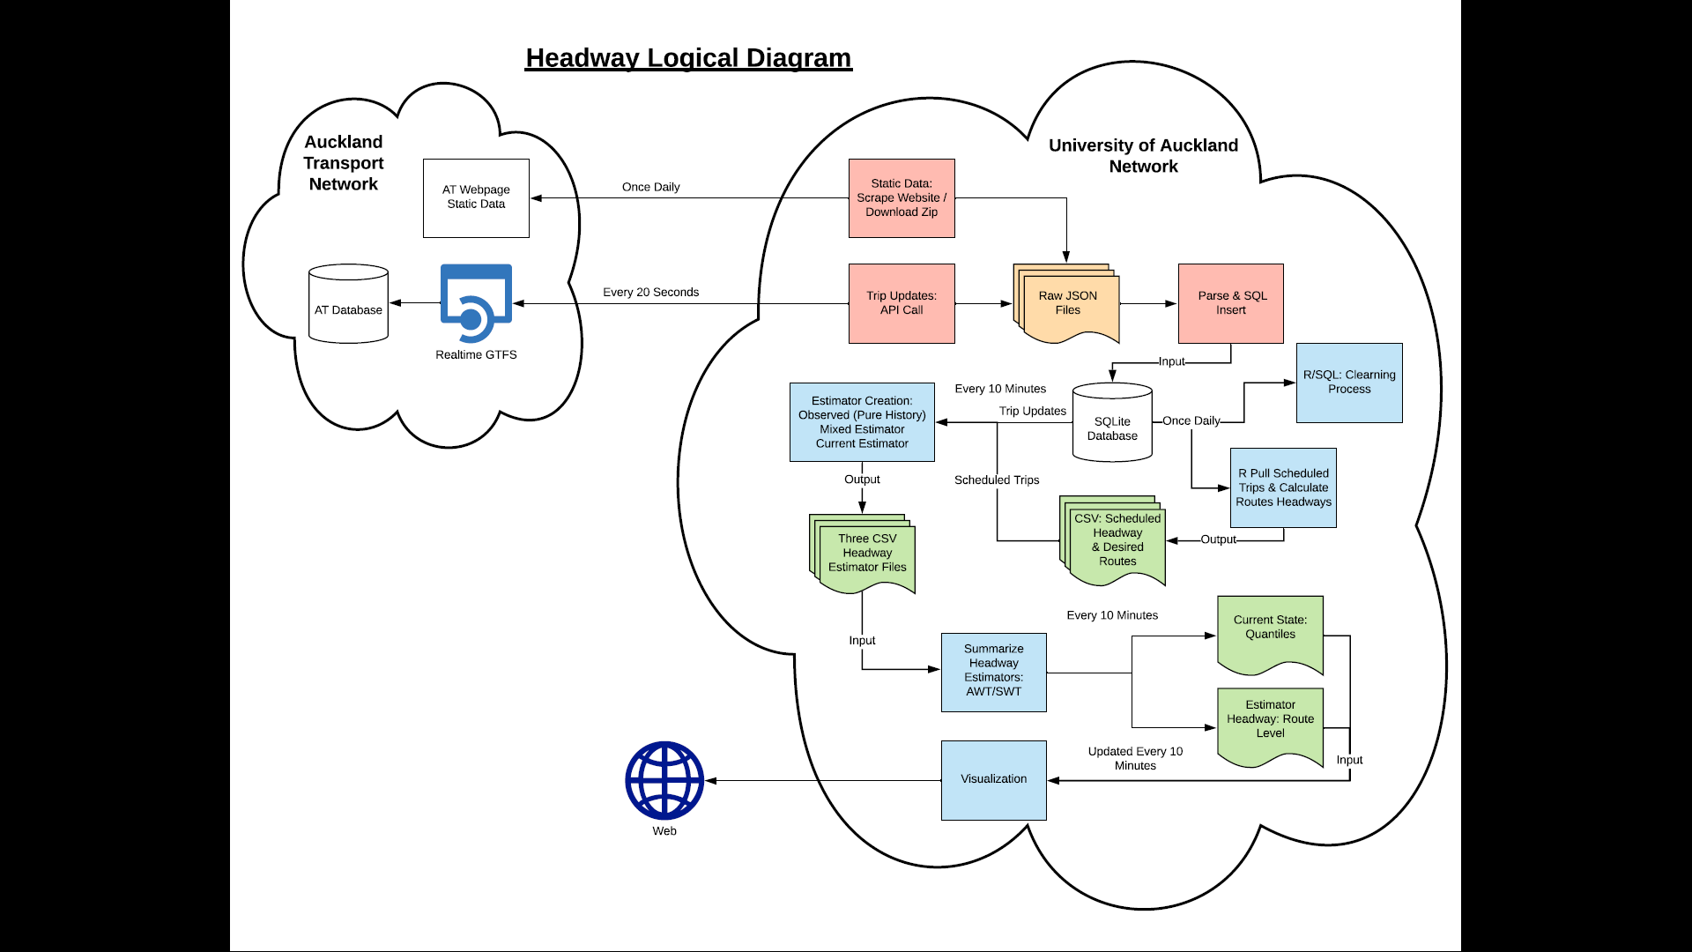
Application Diagram
Components:
Admin
Data Stream/Storage
Headway Estimation
Visualization
R, Python, SQL, Shell
28 Scripts
Headway calculates in approx. 1 minute

Slide 10
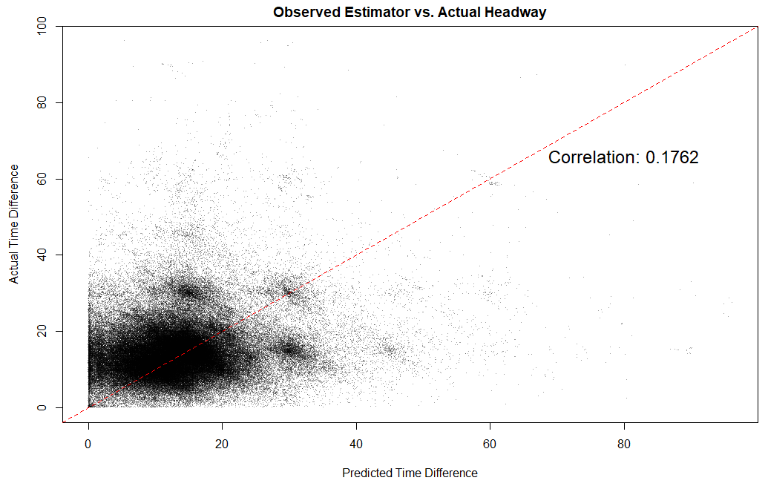
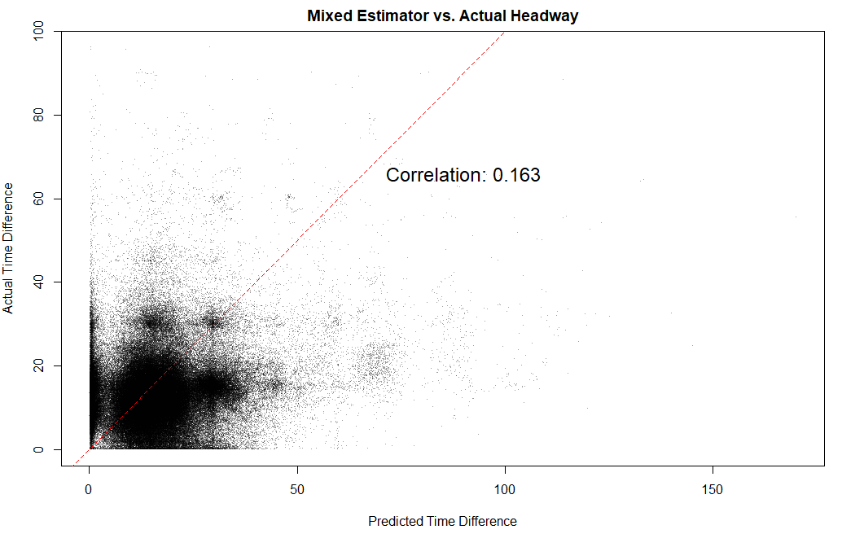
Results
394,336 Datapoints
485,738 Datapoints

Slide 11
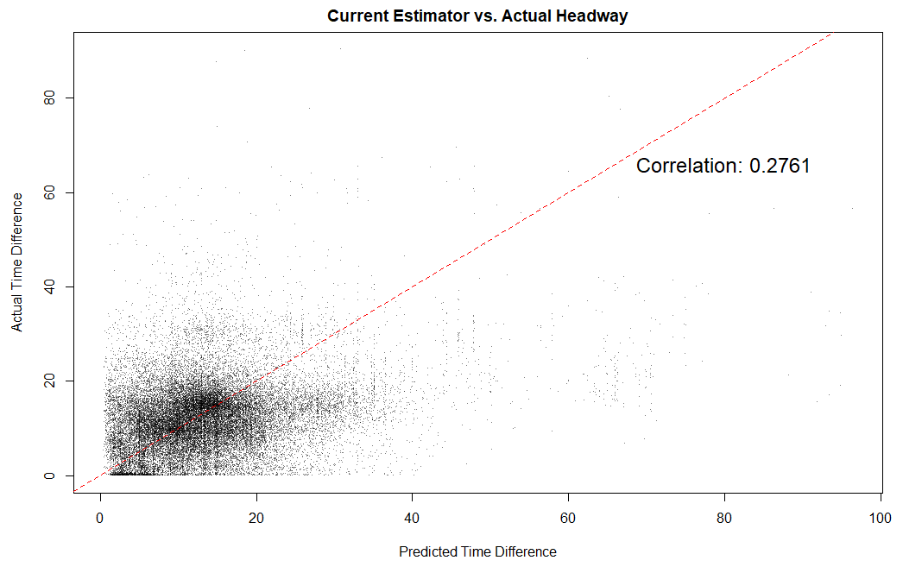
Results
53,354 Datapoints

Slide 12
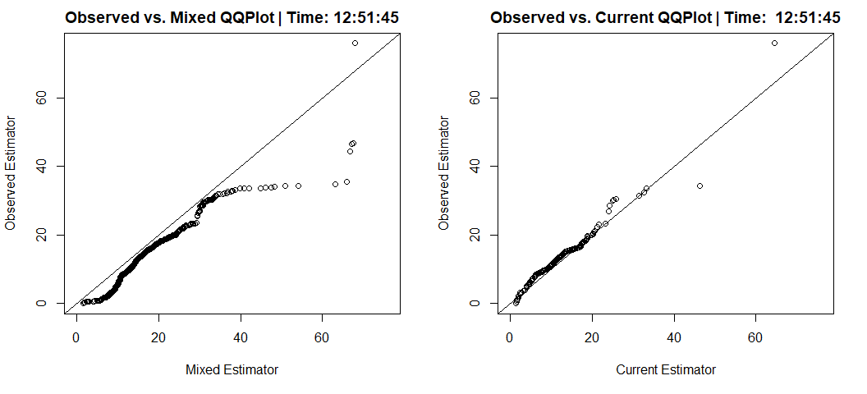
Checking Distributions

Slide 13
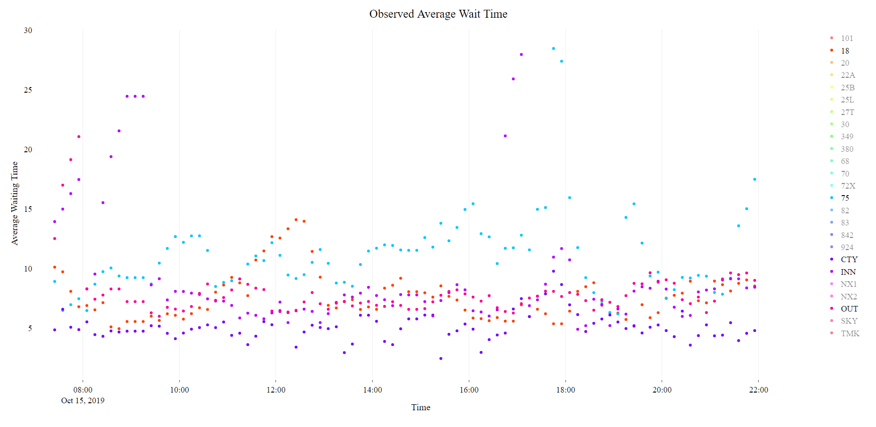
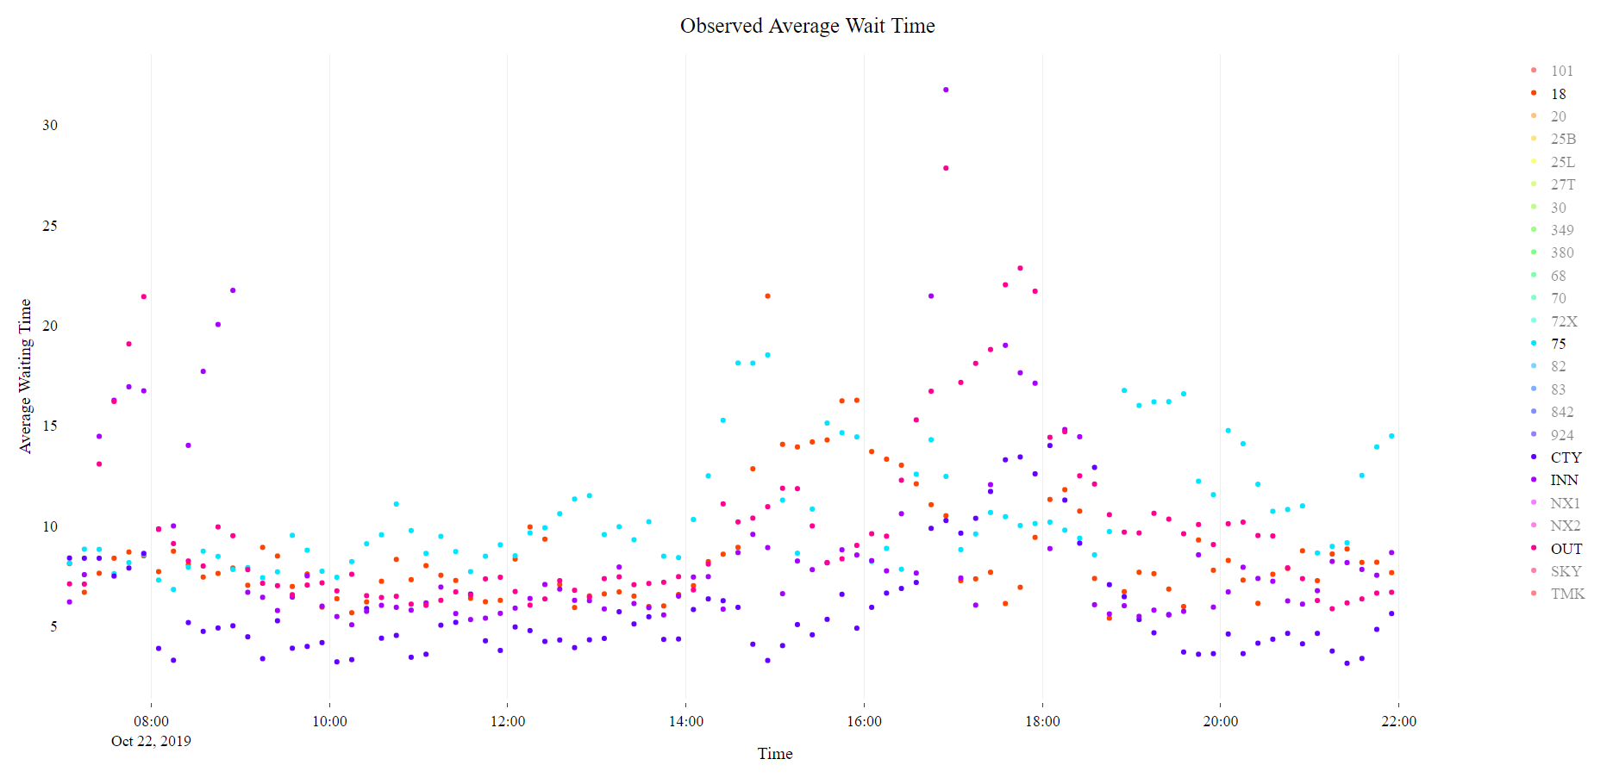
Emergency Delay - Fire

Slide 14
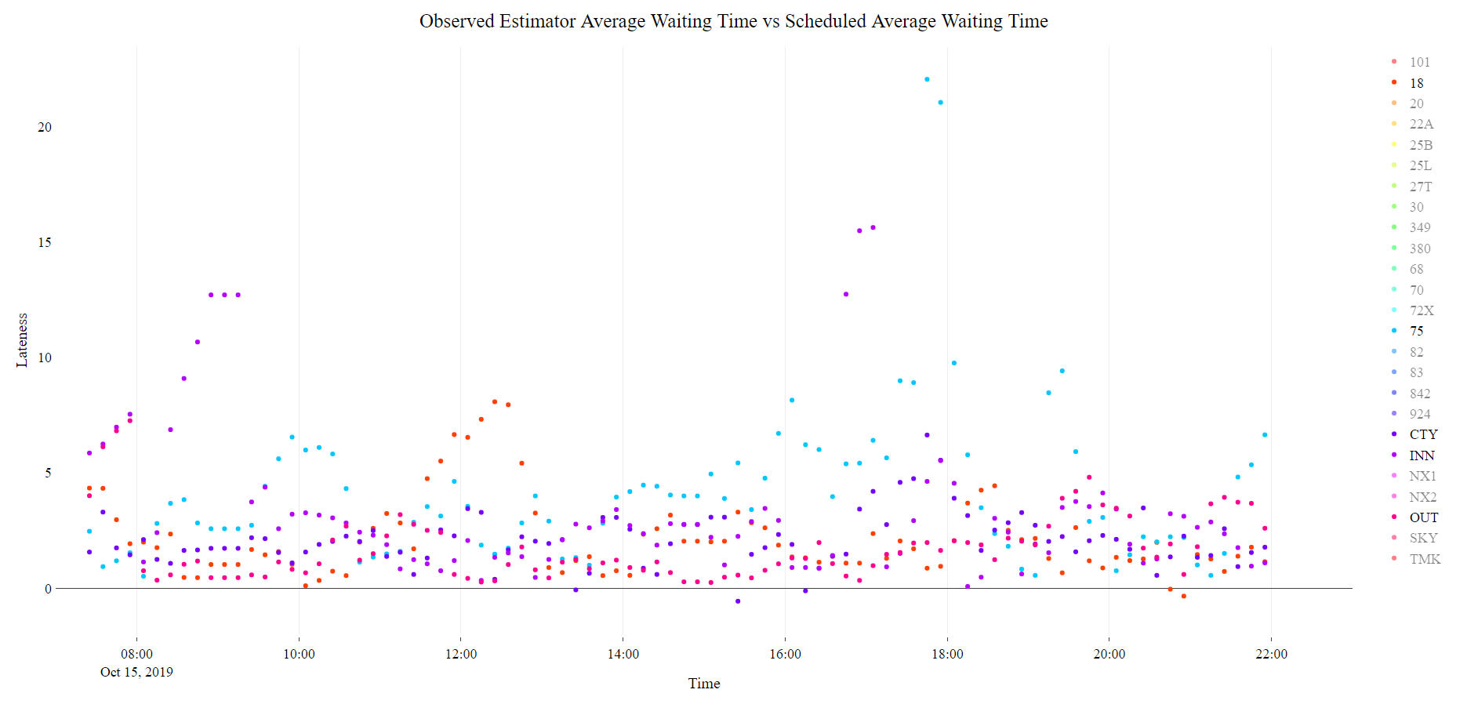
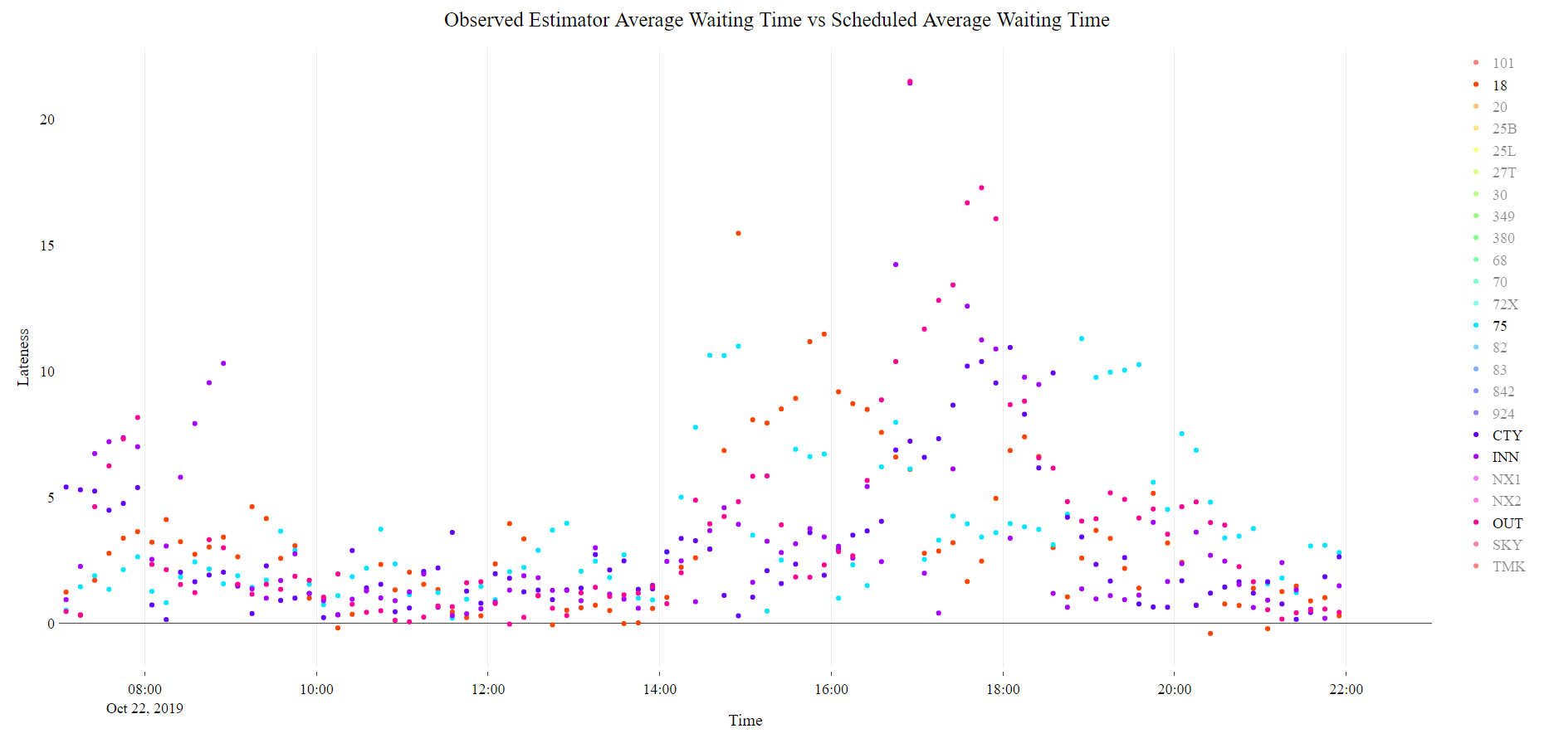
Emergency Delay - Fire

Slide 15
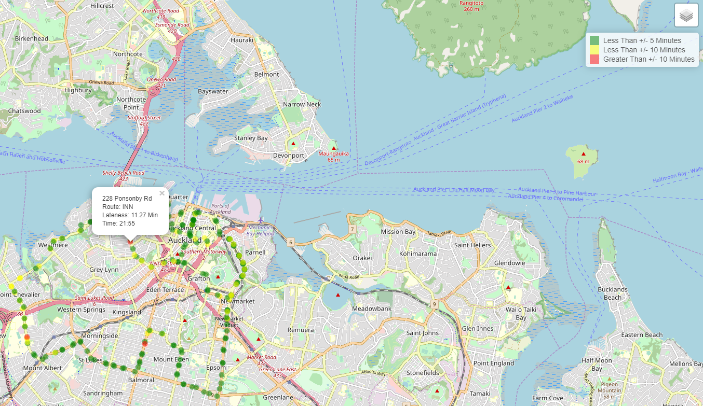

Slide 16
Why These Results?
Headway is actually just uneven
Issues with data quality in the data stream:
Bus operator error
GPS Device issues
Potential bugs in the code
Accurate estimation requires more data

Slide 17
Personal Insights
Pseudocode / Planning
Understanding Data Stream
Sampling/Scaling

